Slide 1
Git & Github

Slide 2
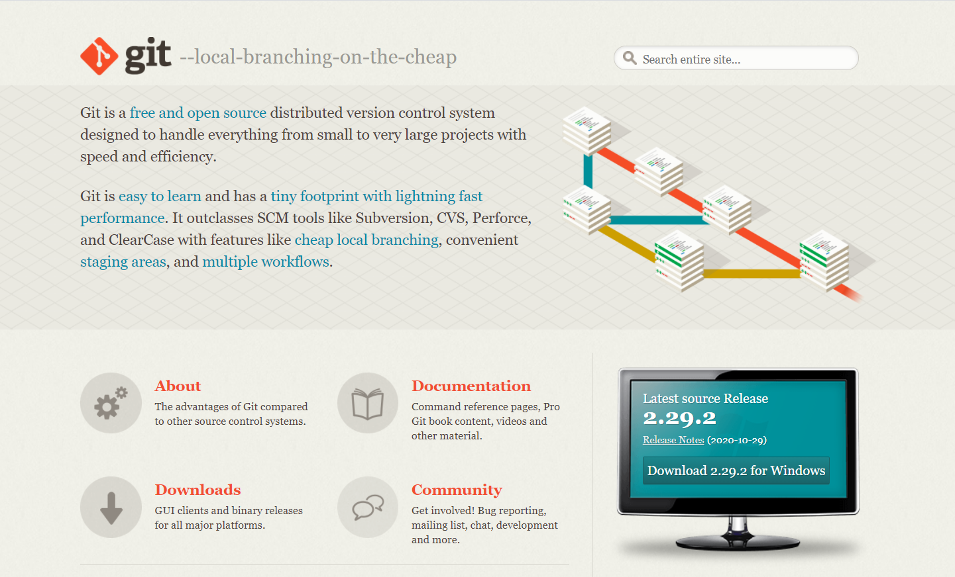
What is Git?

Slide 3
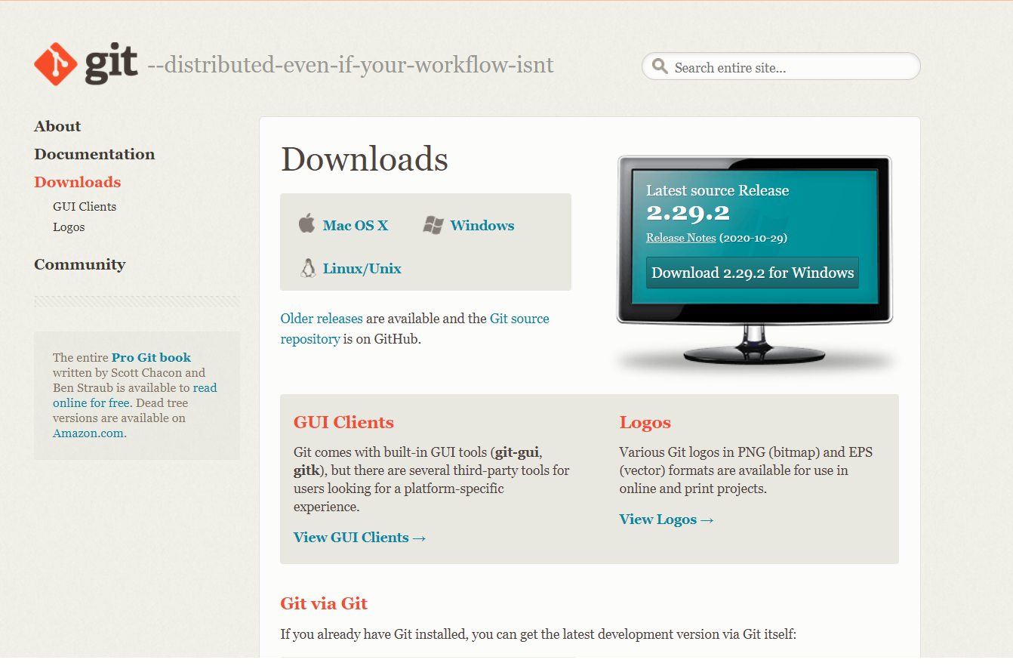
Cont…

Slide 4

What is Github?

Slide 5

Github

Slide 6
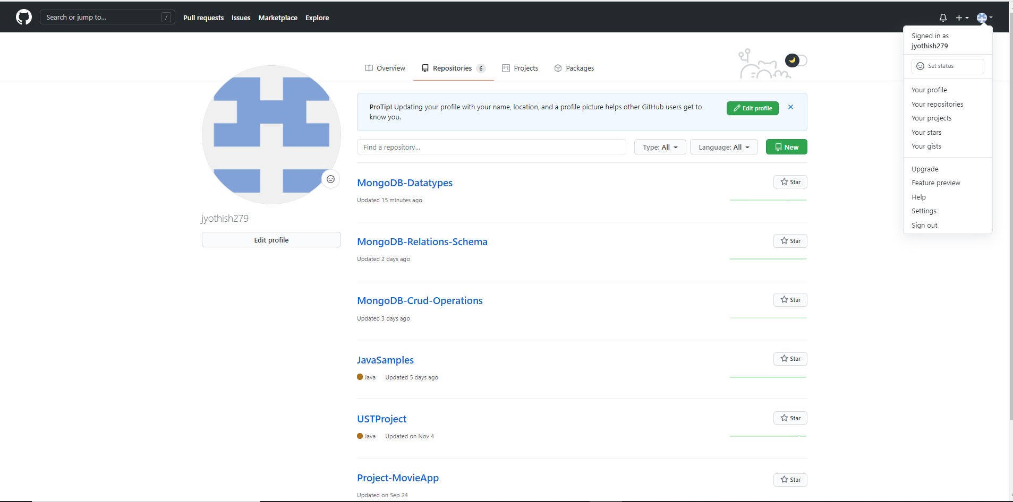
Github Repositories

Slide 7
How to push a code into Github?
* git init
* git add .
* git commit –m “Initial Commit”
* git remote add origin <url>
* git push –u origin master

Slide 8
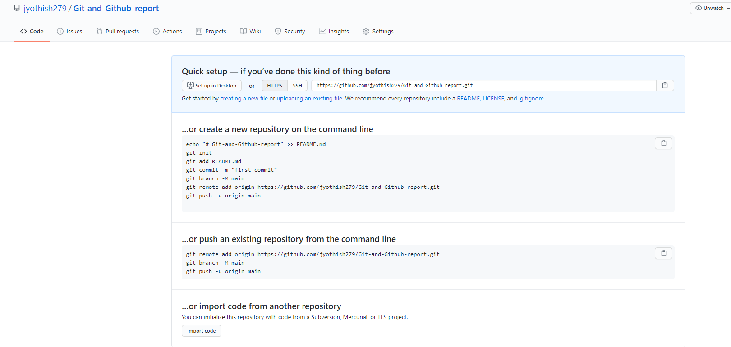
Cont..

